Slide 1
UNIT-1 DIGITAL LOGIC FAMILIES AND INTERFACING
By
Mrs. M.KALPANA

Slide 2
CONTENTS:
INTRODUCTION TO LOGIC FAMILIES
CMOS LOGIC
CMOS STEADY STATE AND DYNAMIC ELECTRICAL BEHAVIUOR
CMOS LOGIC FAMILIES
BIPOLAR LOGIC
TRANSISTOR-TRANSISTOR LOGIC
TTL FAMILIES
CMOS/TTL INTERFACING
EMITTER COUPLED LOGIC

Slide 3
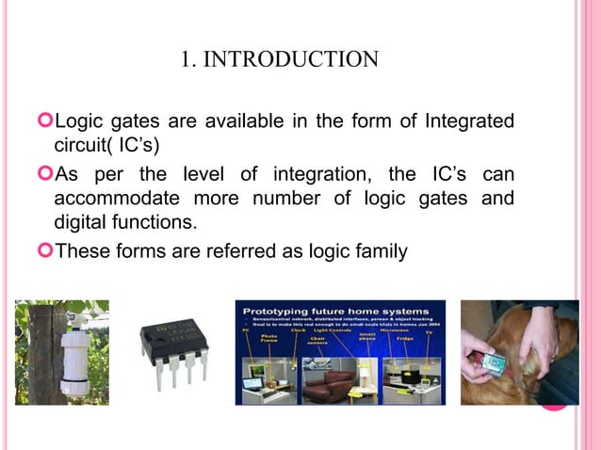
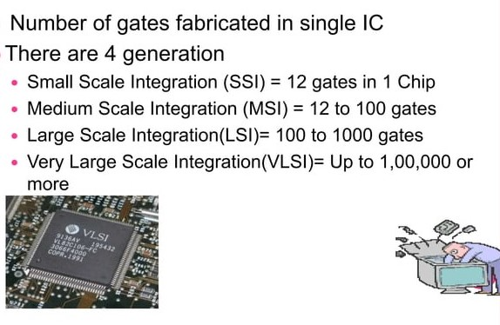
INTRODUCTION

Slide 4
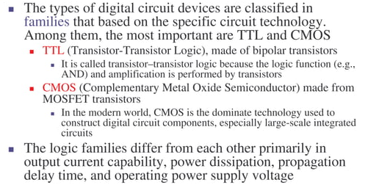

Slide 5
INTRODUCTION TO LOGIC FAMILIES
The digital integrated circuits are designed using bipolar devices or Metal Oxide Semiconductor (MOS) or a combination of both.
There are two kinds of semiconductor devices. The logic family which falls under the first kind Bipolar logic family and the other is Unipolar logic family.
There are two kinds of operations in bipolar integrated circuits: Saturated Bipolar Logic family and Non-saturated Bipolar Logic family.
Unipolar logic family consists of Metal Oxide Semiconductor (MOS) logic families.

Slide 6
CLASSIFICATION OF LOGIC FAMILIES
Logic families are mainly classified as Bipolar Logic Families and Unipolar Logic Families.
Bipolar Logic Families: It mainly uses bipolar devices like diodes, transistors in addition to passive elements like resistors and capacitors. These are sub classified as saturated bipolar logic family and unsaturated bipolar logic family.
Saturated Bipolar Logic Family: In this family the transistors used in ICs are driven into saturation. For example:
Transistor-Transistor Logic (TTL)
Resistor-Transistor Logic (RTL)
Direct Coupled Transistor Logic (DCTL)
Diode Transistor Logic (DTL)
High Threshold Logic(HTL)
Integrated Injection Logic (IIL or I 2 L)

Slide 7
Unsaturated bipolar logic family: In this family the transistors used in IC is not driven into saturation. For example:
Schottky TTL
Emitter Coupled Logic(ECL)
Unipolar Logic Families: It mainly uses Unipolar devices like MOSFETs in addition to passive elements like resistors and capacitors. These logic families have the advantages of high speed and lower power consumption than Bipolar families. These are classified as:
PMOS or P-Channel MOS Logic Family.
NMOS or N-Channel MOS Logic Family.
CMOS Logic Family.

Slide 8
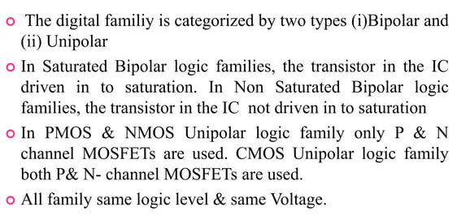
Classification of logic families

Slide 9
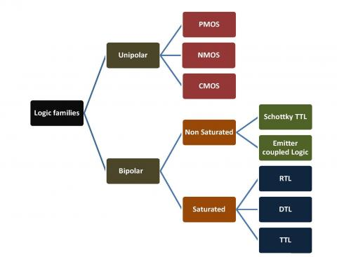

Slide 10
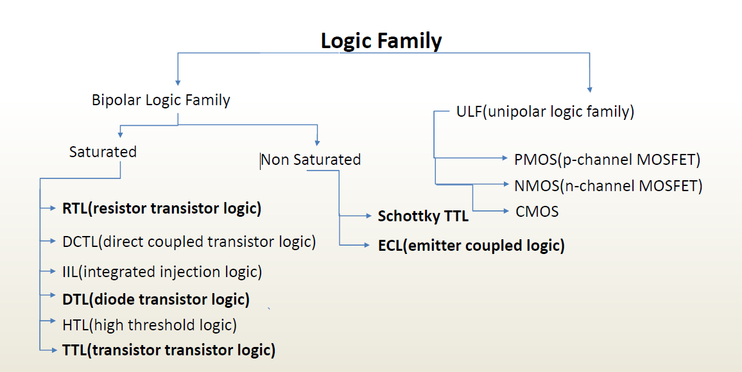

Slide 11
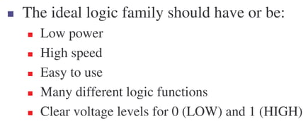
Characteristics of an Ideal Logic Family

Slide 12
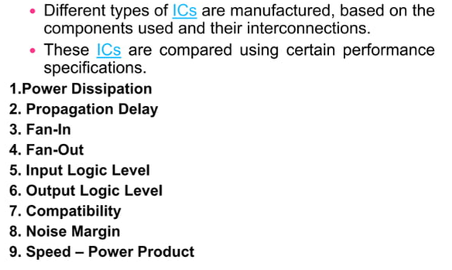
Specifications of Digital IC’s

Slide 13
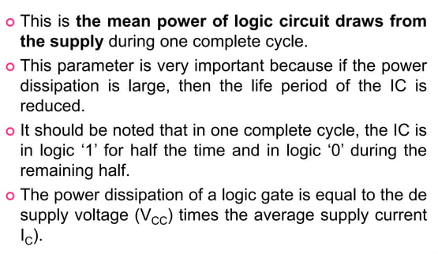
1. Power Dissipation

Slide 14
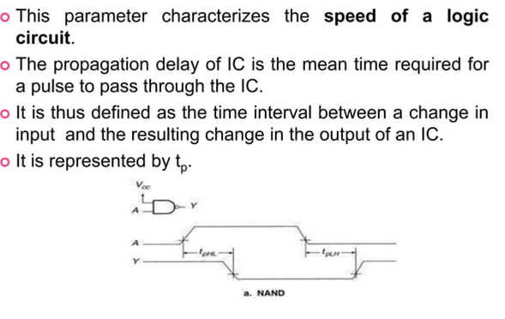
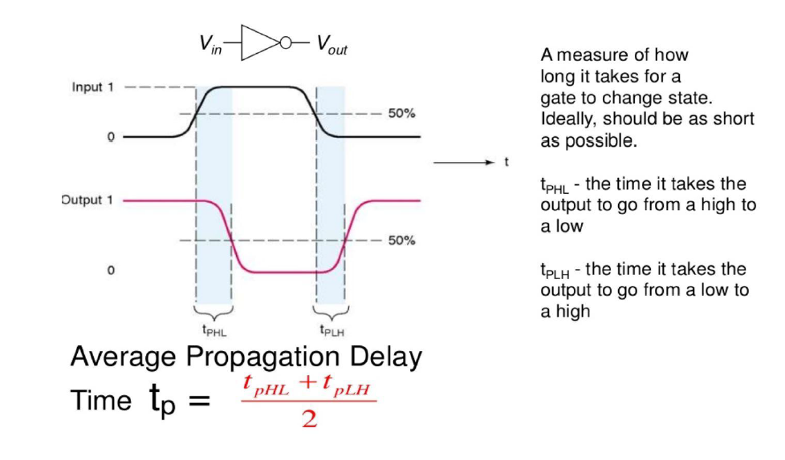
2. Propagation Delay

Slide 15
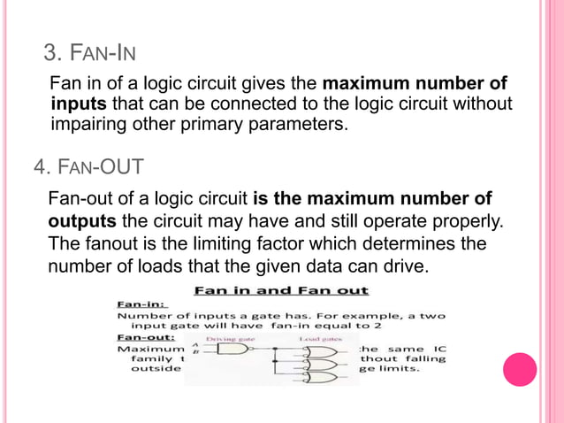
3. FAN-IN
4. FAN-OUT

Slide 16
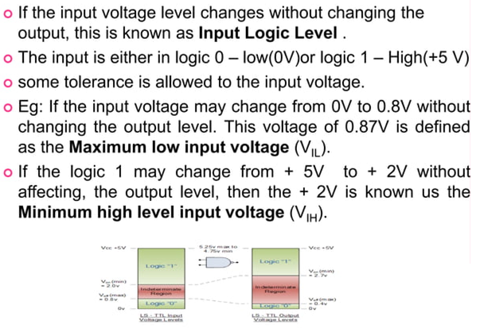
5. Input Logic Level (V_{IL} & V_{IH})

Slide 17
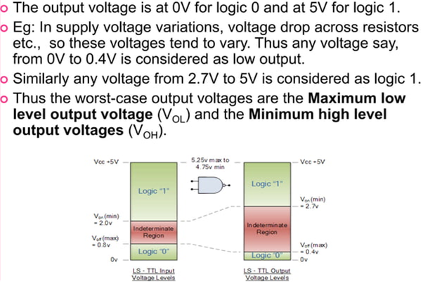
6. Output Logic Level

Slide 18
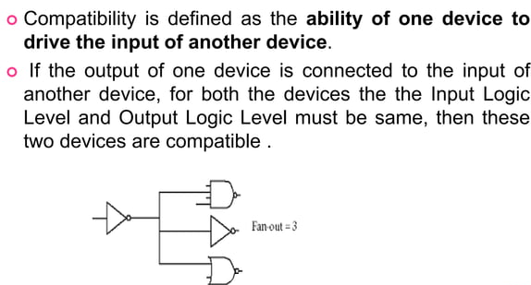
7. Compatibility (Ability to work with another)

Slide 19
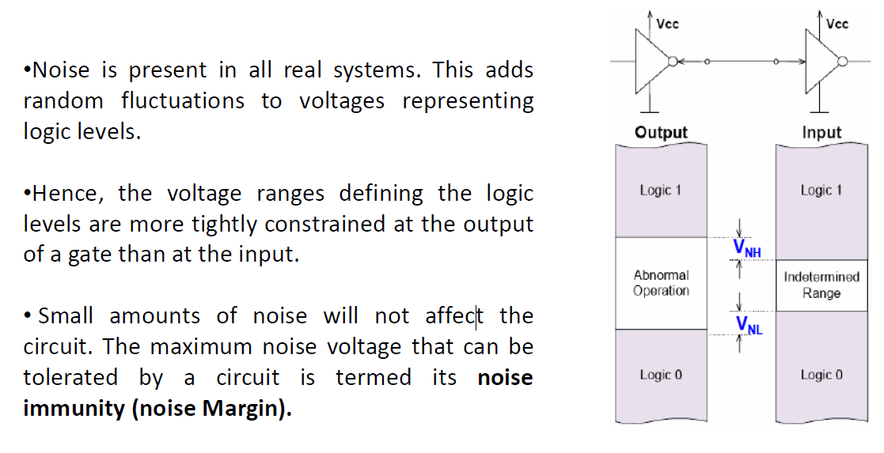
8. Noise Margin

Slide 20
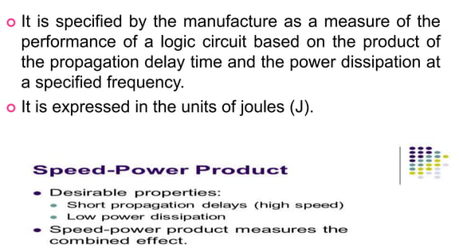
9. Speed-Power Product

Slide 21
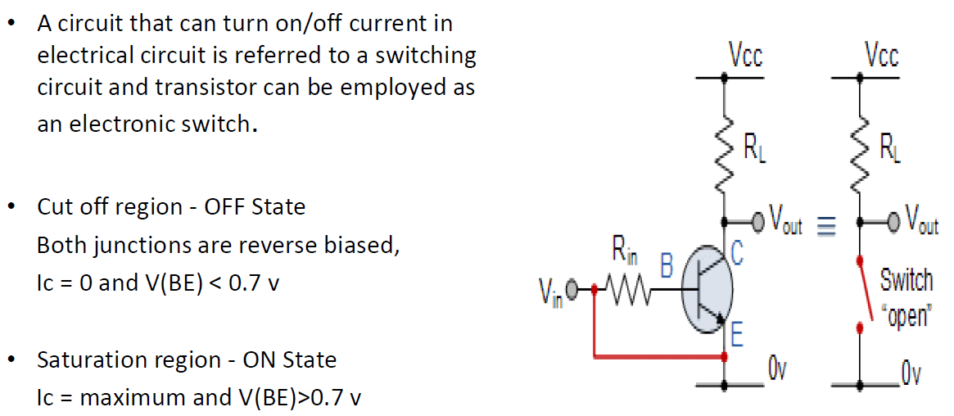
Transistor as a switch

Slide 22
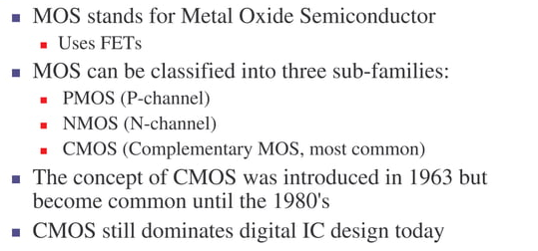
CMOS TECHNOLOGY
CMOS technology provides two types of transistors:
an n-type transistor(nMOS) and a p-type transistor (pMOS).

Slide 23
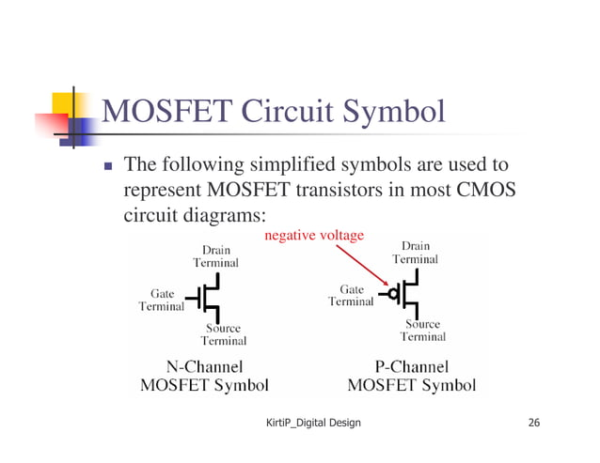
MOSFET Circuit Symbol
MOS principle:
The gate is a control input. It effects the flow of electrical current between source and drain

Slide 24
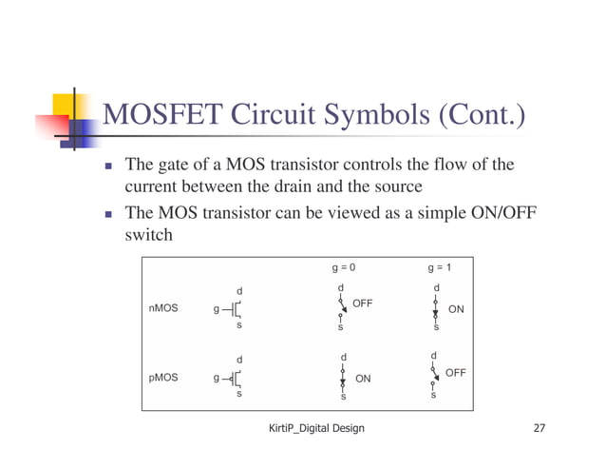

Slide 25
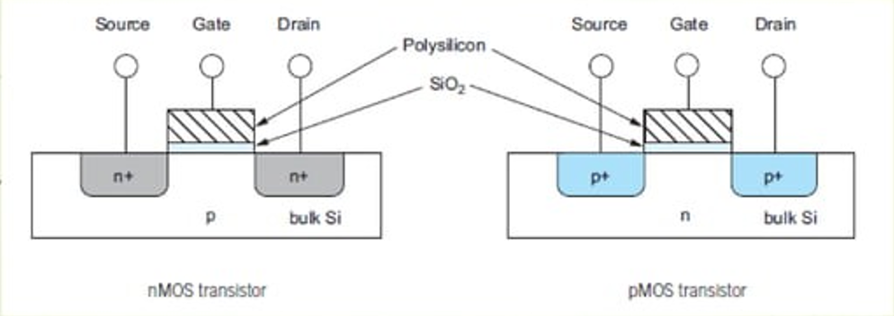
Each transistor consists of a stack of conducting gate, an insulating layer of silicon dioxide(SiO2) and the silicon wafer, also called the substrate .
An nMOS transistor is built with a p-type body and has a regions of n-type semiconductor adjacent to the gate called the source and drain.
A pMOS consists of p-type source and drain regions with an n-type body.
In a CMOS technology, with both flavors of transistors, the substrate is either n-type or p-type.

Slide 26
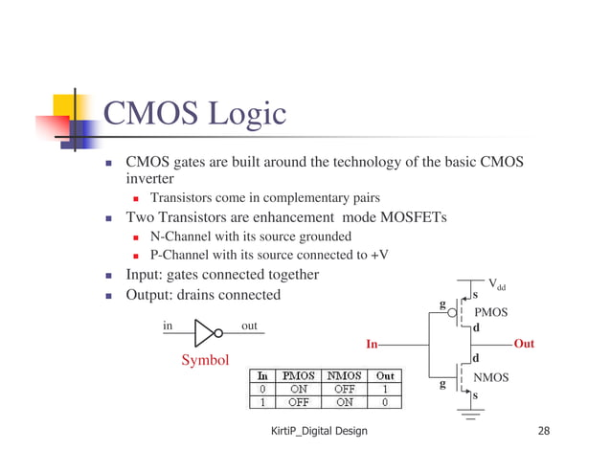
CMOS INVERTER

Slide 27
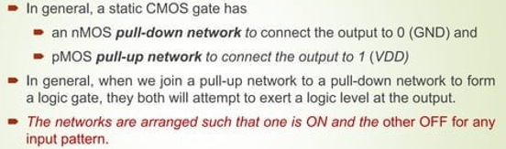
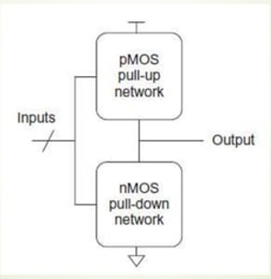
CMOS LOGIC STRUCTURE

Slide 28
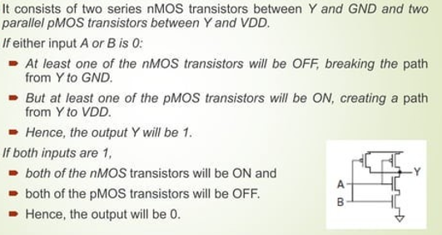
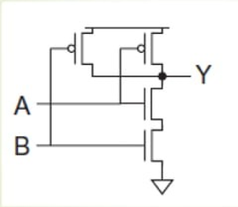
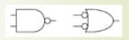
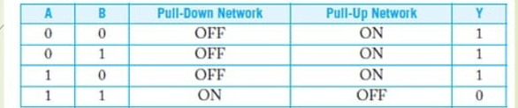
CMOS NAND

Slide 29
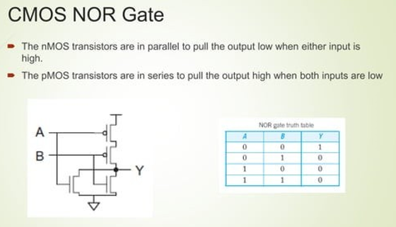

Slide 30
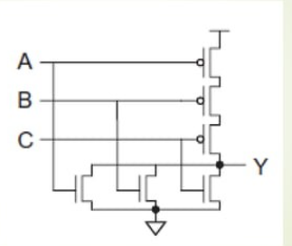
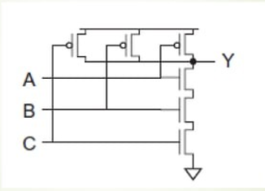
3 Input NOR Gate:
3 Input NAND Gate:

Slide 31
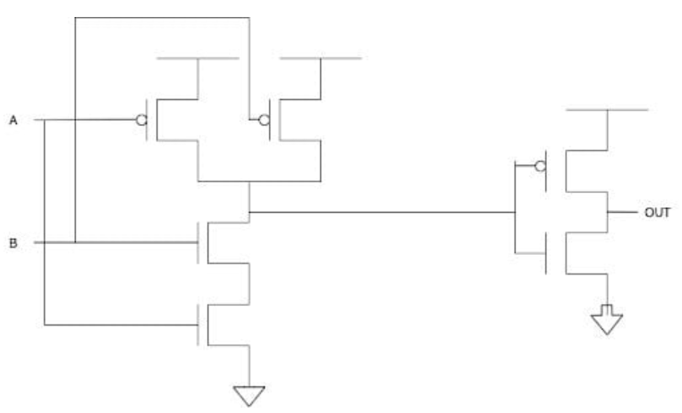
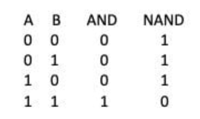
CMOS AND GATE

Slide 32
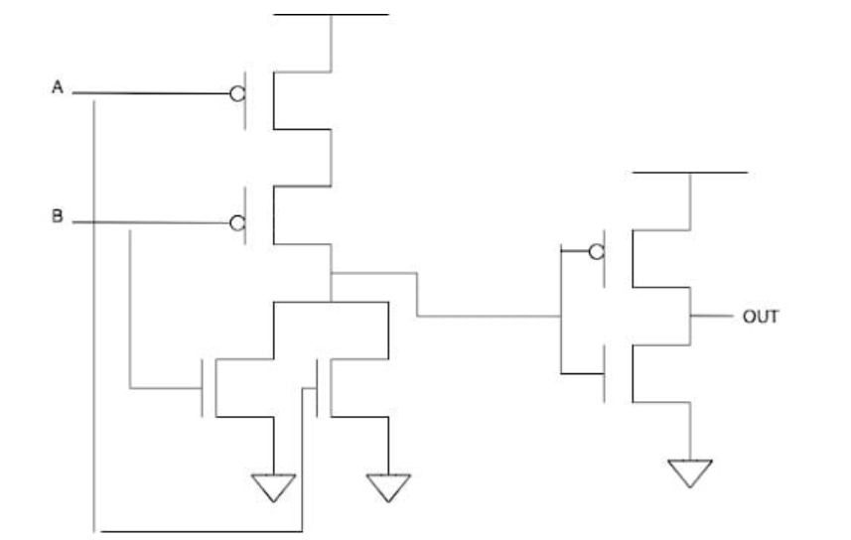
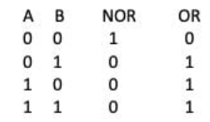
CMOS OR GATE

Slide 33
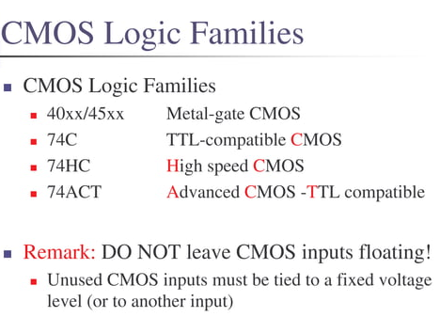

Slide 34
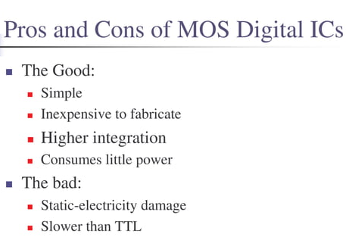

Slide 35
Electrical behavior of the CMOS:
The electrical behavior of CMOS circuits includes the
Steady state electrical behavior
Dynamic electrical behavior
1. Steady state electrical behavior: It is the behavior at the circuit when the inputs & outputs are not changing.
Logic levels & Noise margin:
The CMOS device manufactures specify the four voltage parameters. They are
V_{IH(min)}: High level input voltage
It is the minimum voltage level required for logic 1 at an input. Any voltage below this level will not be accepted as a HIGH by the logic circuit.
V_{IL(max):} Low level input voltage
It is the maximum voltage level required for a Logic 0 at an input. Any voltage above this level will not be accepted as a Low by the logic circuit.

Slide 36
V_{OH(min)}: High level output voltage
It is the minimum voltage level required for logic 1 at an output under defined load conditions.
V_{OL(max):} Low level output voltage
It is the maximum voltage level required for a Logic 0 at an output under defined load conditions.
In practice, due to the unwanted signal called noise, sometimes the voltage at the input drops below V_{IH(min)} or rise above V_{IL(max),} which produces unpredictable operation.
To avoid this problem due to noise, voltage level V_{IH(min)} is kept a few fraction of volts below V_{OH(min)} and V_{IL(min)} is kept above V_{OL(max),} at the design time.

Slide 37
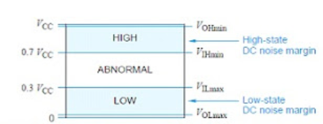
Voltage levels & Noise margins:
V_{OH(min)}: V_{CC} – 0.1V ; V_{IH(min):} 70% of V_{CC}
V_{IL(max)} : 30% of V_{CC} ; V_{OL(max)} : Ground + 0.1V
Fan-in: The maximum no. of digital inputs that a single logic gate can accept.
Fan-out: The maximum no. of digital outputs that the circuit can operate properly.

Slide 38
2. CMOS Dynamic electrical behavior:
The speed & power consumption of CMOS devices are mostly depends on AC or dynamic characteristics of the device and its load.
The AC characteristics refers to the output changes between states.
The speed of the CMOS device depends on 2 characteristics:
Transition time
Propagation delay

Slide 39
Transition time: The amount of time that the output at a logic circuit takes to change from one state to another is called the transition time.
In practice outputs cannot change instantaneously, because
they need time to change.
Rise time(tr): It is the time taken by the output to change from low to high.
Fall time(tf): It is the time taken by the output to change from high to low.
The rise time & fall time of a CMOS output depends mainly on two factors, the ON transistor resistance and the load capacitance. Since increase in load capacitance increases transition time.

Slide 40
2. Propagation delay:
The propagation delay is the amount of time that it takes for a change in the input signal for produce in the output signal.
The shorter propagation delay, the higher the speed of the circuit & vice-versa
The propagation delay is determined using two basic time intervals.
t_{PLH}: It is the delay time measured when output is changing from logic 0 to logic 1.
t_{PHL}: It is the delay time measured when output is changing from logic 1 to logic 0.
t_{PHL}
t_{PLH}

Slide 41
Resistor Transistor Logic (RTL)
Resistor–transistor logic (RTL) (sometimes also transistor–resistor logic (TRL)) is a class of digital circuits built using resistors as the input network and bipolar junction transistors (BJTs) as switching devices.
RTL is the earliest class of transistorized digital logic circuit; it was succeeded by diode–transistor logic (DTL) and transistor–transistor logic(TTL).
RTL circuits were first constructed with discrete components but in 1961 it became the first digital logic family to be produced as a monolithic integrated circuit.
Here Transistors used in Saturation and Cut-off region. So speed of this logic family is low.

Slide 42
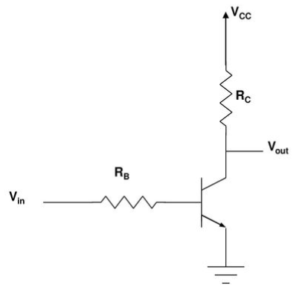
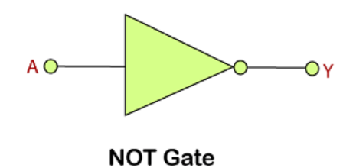
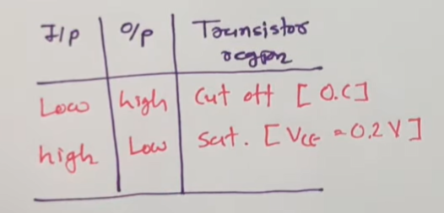
RTL INVERTER

Slide 43
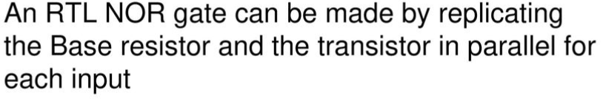
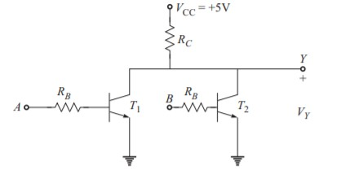
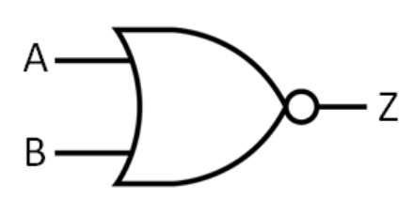
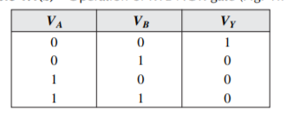
RTL NOR GATE
Disadvantages:
Low noise margin
Low speed
Low fan out
High power dissipation

Slide 44
Advantages:
The primary advantage of RTL technology was that it used a minimum number of transistors.
In circuits using discrete components, before integrated circuits, transistors were the most expensive component to produce.
Early IC logic production (such as Fairchild's in 1961) used the same approach briefly, but quickly transitioned to higher-performance circuits such as diode–transistor logic and then transistor–transistor logic (starting in 1963 at Sylvania Electric Products), since diodes and transistors were no more expensive than resistors in the IC.
Limitations:
The disadvantage of RTL is its high power dissipation when the transistor is switched on, by current flowing in the collector and base resistors.
This requires that more current be supplied to and heat be removed from RTL circuits.
In contrast, TTL circuits with "totem-pole" output stage minimize both of these requirements
Another limitation of RTL is its limited fan-in: 3 inputs being the limit for many circuit designs, before it completely loses usable noise immunity. It has a low noise margin.

Slide 45
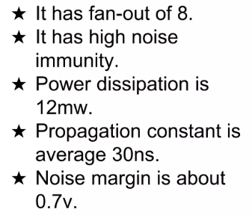
Diode Transistor Logic (DTL)
Diode–transistor logic (DTL) is a class of digital circuits It is called so because the logic gating functions AND and OR are performed by diode logic, while logical inversion (NOT) and amplification (providing signal restoration) is performed by a transistor (in contrast with RTL and TTL).
Disadvantages:
Low speed
Power dissipation as heat

Slide 46
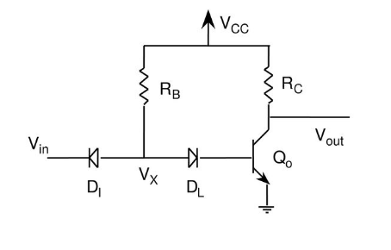
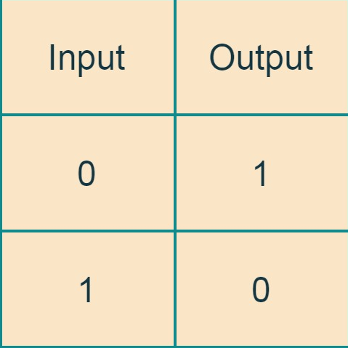
DTL INVERTER:

Slide 47
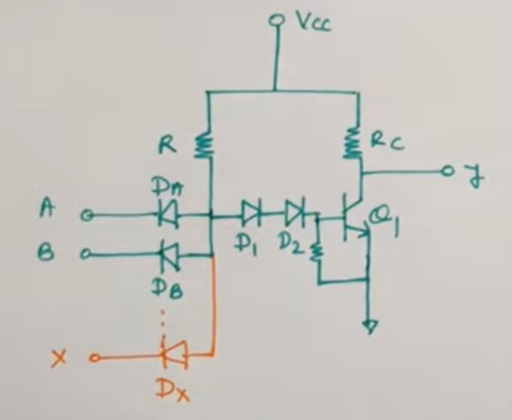


DTL NAND GATE
Diode-Transistor Logic (DTL): The basic circuit in the DTL logic is the NAND gate.
Each input associated with one diode.
The diode and resistor form an AND gate.
The transistor amplifies the output

Slide 48
Case 1:
A=0, B=0 => D_{A} & D_{B}-F.B; D₁&D₂ - R.B,
Q₁-OFF. Then Y=1
Case 2:
A=0, B=1 => D_{A} - F.B & D_{B} – R.B; D₁ & D₂-R.B, Q₁-OFF. Then Y=1
Case 3:
A=1, B=0 => D_{A} - R.B & D_{B} – F.B; D₁ & D₂-R.B, Q₁-OFF. Then Y=1
Case 4:
A=1, B=1 => D_{A} & D_{B} – R.B; D₁ & D₂ - F.B,
Q₁-ON. Then Y=0

Slide 49
TRANSISTOR TRANSISTOR LOGIC (TTL)
Transistor–transistor logic (TTL) is a logic family built from bipolar junction transistors. Its name signifies that transistors perform both the logic function (the first "transistor") and the amplifying function (the second "transistor"), as opposed to earlier resistor–transistor logic (RTL) and diode-transistor logic (DTL).
TTL integrated circuits(ICs) were widely used in applications such as computers, industrial controls, test equipment and instrumentation, consumer electronics, and synthesizers.
TTL manufacturers offered a wide range of logic gates, flip-flops, counters, and other circuits.

Slide 50

TTL circuit design offered higher speed or lower power dissipation to allow design optimization.
As transistor becomes ON and OFF much rapidly than a diode, switching time will be faster.
TTL or Transistor-transistor logic replaced resistor-transistor logic, and used much less power.
The TTL family is very fast and reliable, and newer faster, less power-consuming, etc.
Transistor-Transistor Logic (TTL): uses multiple emitter transistor at the input.
TTL Classifications:
Standard TTL
TTL Totempole output
TTL open collector output
TTL Tristate

Slide 51



TTL NAND GATE
Case 1:
If any of the input is low, then T1 is in active region.
Diode (BE) forward biased and diode (BC) reverse biased.
T2 – OFF; T3 – OFF; Output - HIGH
Case 2:
If all the input is HIGH
Diode (BE) reverse biased and diode (BC) forward biased.
T2 – ON; T3 – ON; Output - LOW
Drawback:
When T3-ON; R is HIGH
When T3-OFF; R is LOW

Slide 52


TTL NAND GATE WITH TOTEMPOLE OUTPUT
Case 1:
If any of the input is low, then T1 is in active region.
Diode (BE) forward biased and diode (BC) reverse biased.
T2 – OFF; T3 – OFF
T4 - ON
Output - HIGH
Case 2:
If all the input is HIGH
Diode (BE) reverse biased and diode (BC) forward biased.
T2 – ON; T3 – ON
T4 - OFF
Output - LOW
Fanout & Noise margin improved by using totempole circuit at output.

Slide 53



TTL NOR GATE USING TOTEMPOLE
Case 1:
If both the inputs low, then T1 & T2 - BE forward biased and diode & BC reverse biased.
T3 – OFF; T4 – OFF
T5 – OFF; T6 - ON
Output - HIGH
Case 2:
If A==1, B=1, then
T1 & T2 - BE reverse biased and diode & BC forward biased.
T3 – ON; T4 – ON
T5 – ON; T6 - OFF
Output - LOW

Slide 54
Case 3:
If A==0, B=1, then
T1 -(BE) forward biased and diode (BC) reverse biased.
T2 - (BE) reverse biased and diode (BC) forward biased
T3 – OFF; T4 – ON; T5 – ON; T6 - OFF
Output - LOW
Case 4:If A==1, B=0, then
T1 -(BE) reverse biased and diode (BC) forward biased.
T2 - (BE) forward biased and diode (BC) reverse biased
T3 – ON; T4 – OFF; T5 – ON; T6 - OFF
Output - LOW

Slide 55


TTL OPEN COLLECTOR NAND GATE
Case 1:
If any of the inputs LOW,
Then T1 - BE forward biased & BC reverse biased.
T2 – OFF; T3 – OFF
Output - HIGH
Case 2:
If both the inputs HIGH,
Then T1 - BE reverse biased & BC forward biased.
T2 – ON; T3 – ON
Output – LOW

Slide 56

TTL TRISTATE LOGIC
In Tristate at the output there are 3 states.
Logic high
Logic low
High impedance state
Case 1:
Enable=0, A is either 0 or 1
D1-FB
T2 – OFF; T3 – OFF; ; T4 – OFF
Output – At High impedance level
Case 2:
Enable=1, D1-RB; A =0
Then T1 - BE forward biased & BC reverse biased.
T2 – OFF; T3 – OFF; ; T4 – ON
Output – High

Slide 57
Case 3:
Enable=1, D1-RB; A =1
Then T1 - BE reverse biased & BC forward biased.
T2 – ON; T3 – ON; ; T4 – OFF
Output – Low
NOTE: 3 States
Enable=0 => High impedance
Enable=1
(i) A=0 => Output – High
(ii) A=1 => Output – Low

Slide 58
EMITTER COUPLED LOGIC
ECL was invented in August 1956 at IBM
Originally called current-steering logic. The logic was also called a current mode circuit
Positive ECL (Vcc=+5v, VEE=0v) and Negative ECL (VEE=-5.2V, VCC=0v)
ECL achieves its high speed operation
In the late 1960s, when the standard TTL family offered 20ns gate delay and the CMOS 4000 family had delays of 100ns or more, ECL offered an incredible delay of only 1ns
ECL is a High speed logic family based on bipolar transistor
It basically operates on current mode of operation
Transistors are driven either in cut-off or in active region.
It is the fastest of all the logic families. Propagation delay is less than 1ns per gate.
It is differential logic.

Slide 59

ECL INVERTER / BUFFER GATE
The input LOW level is 3.6V
The input HIGH level is 4.4V
This circuit produces output LOW and HIGH levels that are 4.2 and 5V.
The outputs of this inverter are called differential outputs because they are always complementary.
The output is 1 if (Vout1-Vout2) > 0 and it is 0 if (Vout1-Vout2) < 0

Slide 60
OPERATION OF ECL INVERTER / BUFFER GATE
CASE-1: Input is logic HIGH=4.4V applied to Q1
VBB=4V – reference voltage
Q1 – ON for 4.4V
At emitter junction voltage is 4.4 - VBE = 4.4 - 0.6 = 3.8V
At Q2, input is 4v and emitter voltage is 3.8V.
So VBE=4-3.8=0.2V. So Q2-OFF
In the first branch some amount of current flows. In the second branch current is zero.
VC2= Vcc-IR2=5-0=5V - Logic HIGH
VC1=Vcc–(IE * R1)= 5 – 2.9mA*300=4.2V - Logic LOW
IE=VE / R3= 3.8/1.3KΩ=2.9mA
Vin= 4.4V (LOGIC HIGH)
Outputs: VC1=4.2V (LOGIC LOW) – Inverter output ;
VC2=5V (LOGIC HIGH) – Buffer output

Slide 61
CASE-2: Input is logic LOW=3.6V applied to Q1
VBB=4V – reference voltage applied to Q2
Q2 – ON for 4V
At emitter junction voltage is 4 - VBE = 4 - 0.6 = 3.4V
At Q1, input is 3.6v and emitter voltage is 3.4V.
So VBE=3.6-3.4=0.2V. So Q1-OFF
In the second branch some amount of current flows. In the first branch current is zero.
VC1= Vcc-IR1=5-0=5V - Logic HIGH
VC2=Vcc–(IE * R2)= 5 – 2.9mA*300=4.2V - Logic LOW
IE=VE / R3= 3.8/1.3KΩ=2.9mA
Vin= 3.6V (LOGIC LOW)
Outputs: VC1=5V (LOGIC HIGH) – Inverter output ;
VC2=5V (LOGIC HIGH) – Buffer output

Slide 62


ECL NOR / OR GATE
a | b | Vout1 | Vout2
3.6 | 3.6 | 5 | 4.2
0 | 0 | 1 | 0
 |  | NOR | OR
CASE-1: a=b=0=3.6V
Q1a, Q1b – OFF; Q2- ON
Vout1=VC1=VCC=5V (Logic HIGH)
Vout2=VC2=4.2V (Logic LOW)
CASE-2: a=0=3.6V, b=1=4.4V
Q1a=OFF; Q1b – ON; Q2- OFF
Vout1=VC1=VCC-I_{E}R1=4.2V (Logic LOW)
Vout2=VC2=5V (Logic HIGH)
a | b | Vout1 | Vout2
3.6 | 4.4 | 4.2 | 5
0 | 1 | 0 | 1
 |  | NOR | OR
CASE-3: a=1=4.4V, b=0=3.6V
Q1a=ON; Q1b – OFF; Q2- OFF
Vout1=VC1=VCC-I_{E}R1=4.2V (Logic LOW)
Vout2=VC2=5V (Logic HIGH)
a | b | Vout1 | Vout2
4.4 | 3.6 | 4.2 | 5
1 | 0 | 0 | 1
 |  | NOR | OR
CASE-4: a=b=1=4.4V
Q1a = Q1b = ON; Q2- OFF
Vout1=VC1=VCC-I_{E}R1=4.2V (Logic LOW)
Vout2=VC2=5V (Logic HIGH)
a | b | Vout1 | Vout2
4.4 | 4.4 | 4.2 | 5
1 | 1 | 0 | 1
 |  | NOR | OR

Slide 63
ECL Logic Families
Came from Motorola
ECL 10K/10H Families
Voltage Compensated
Came from Fairchild
ECL 100K Families Voltage & Temperature Compensated

Slide 64

3 stages
Differential stage
Biasing stage
Emitter follower stage

Slide 65
Advantages & Disadvantages of ECL
Advantages:
Fastest logic family
Low gate delays
High fan-out capability
Low power consumption
Compatibility with other logic families
Disadvantages:
Negative supply
High static power dissipation
Limited choice of manufacturers and devices
Low noise margin

Slide 66
Comparison between Logic Families
S.No. | Parameter | CMOS | TTL | ECL
1 | Device used | NMOS & PMOS | BJT | BJT
2 | Basic gate | NAND/NOR | NAND | NOR/OR
3 | Propagation Delay | 70ns | 10ns | 500ps
4 | Switching speed | Less than TTL | Faster than CMOS | Fastest
5 | Power Dissipation per gate | 0.1mW | 10mW | 25mW
6 | Power Dissipation | Increases with frequency | Increases with frequency | Constant with frequency
7 | Fan out | 50 | 10 | 25
8 | Power Supply Voltage | 3-15V | Fixed 5V | -4.5 to 5.2V
9 | Noise Immunity | Excellent | Very good | Good
10 | Applications | Portable instrument where battery supply is used | Laboratory instruments | High speed instruments

